Slide 1
Fantasy Football Analysis
By: David Parsons

Slide 2

Overview
Analyze football data to help make better decisions
Find the best players
Done by position and season basis
Find which opposing teams are the best matchups for players

Slide 3
Data Overview
Created web scrapper to pull data from pro-football-reference.com into a pandas data frame
Pulled game data for top players in 2019-2021

Slide 4
Fantasy Football Analysis
Best seasons by positions
Best players over 2019-2021 period
Top scoring games
Best opponent matchups by position

Slide 5
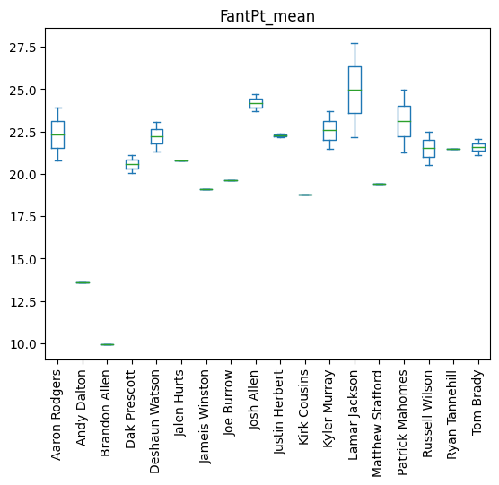
Top Scoring QBs
Lamar Jackson was the highest scoring QB between 2019-21 Jackson also had the highest season overall in 2019 Josh Allen and Patrick Mahomes were the only other QBs to average over 23 FantPts per game

Slide 6
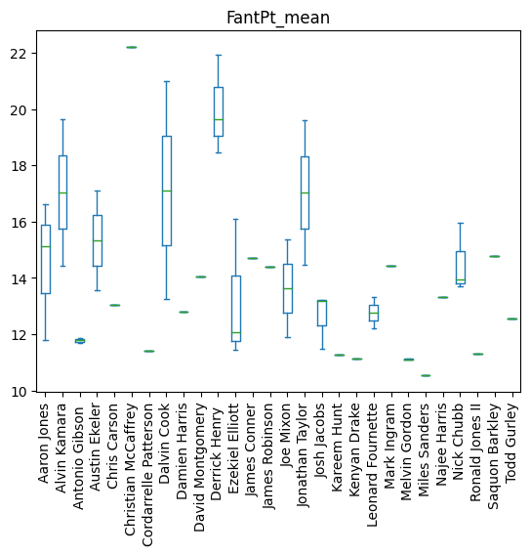
Top Scoring RBs
Christian McCaffery’s 2019 season was the best RB season.
Derrick Henry was had the highest average score between 2019-21
Six RBs averaged over 15 FantPts a game during this timeframe

Slide 7
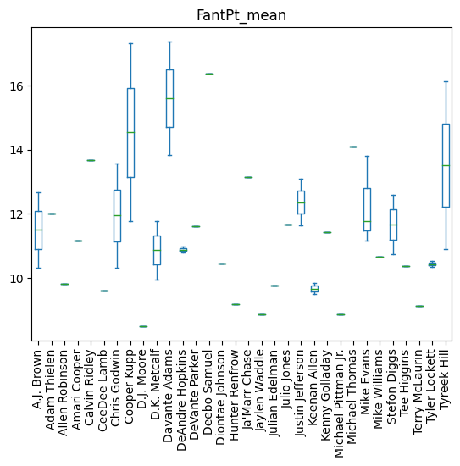
Top Scoring WRs
Cooper Kupp had the best WR season (2021)
WRs had more volatility in who was a top scorer on a year-to-year basis
Overall WRs scored less than both QBs and RBs

Slide 8
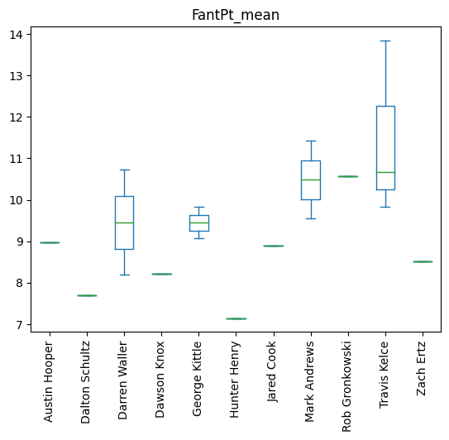
Top Scoring TEs
TE production only had two players have seasons with over 11 FantPt (Travis kelce and Mark Andrews)
Largest gap between top TEs and lower tiered TEs

Slide 9
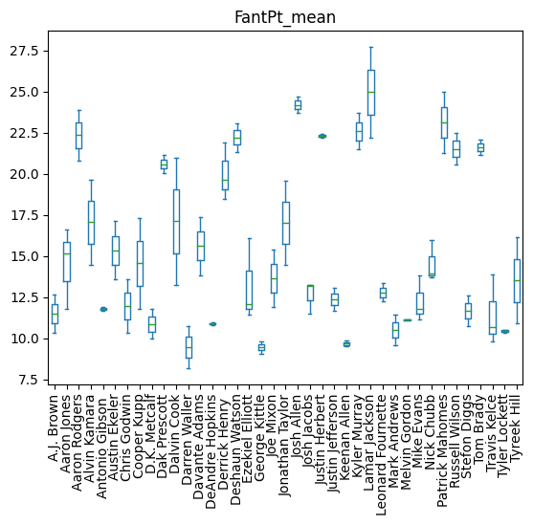
Best Players over 2019-21
Over 2019-21 timeframe Lamar Jackson was overall highest scoring player.
There is separation between best RBs/WRs and TEs

Slide 10
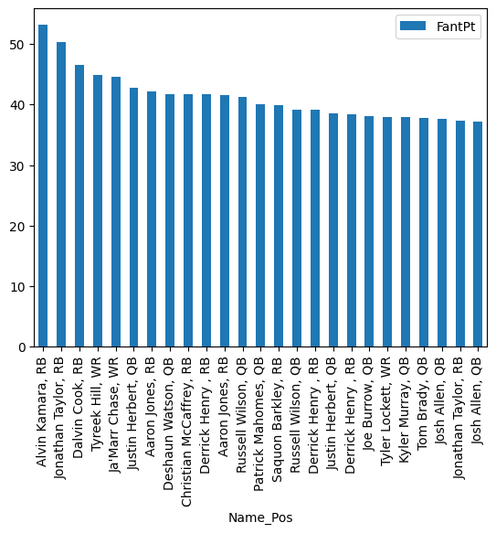
Highest Scoring Games
Position Breakdown of 25 highest Scoring Games:
11 QBs , 11 RBs, 3 WRs, 0 TEs
Derrick Henry had most with 3

Slide 11
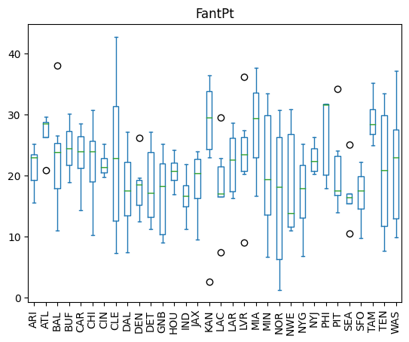
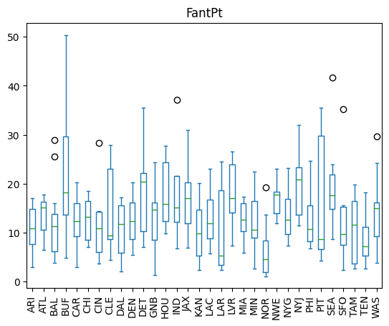
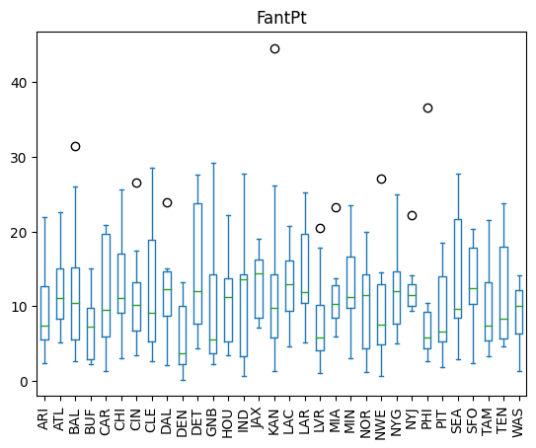
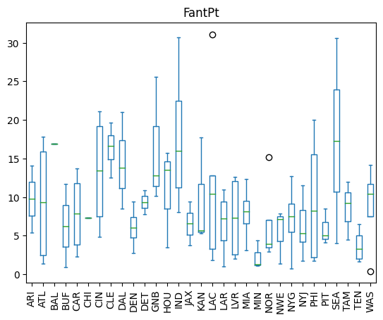
Opposing Defense FantPts Allowed by Position
QB
RB
KC gives up most QB scoring on average. Also had lowest score allowed to QB
Mean WR scoring by team is even, but some teams have higher ranges
NYJ was easiest opponent for RBS
SEA was easiest opponent for TEs
WR
TE

